Slide 1
LPP Using Simplex Method

Slide 2
Overview
Slack Variable
Variable added to a <= Constraint to convert it to an Equation (=)
Slack Variable indicates unused resources
A Slack Variable contributes nothing to objective function values
Surplus Variables
Variable subtracted from a >= constraint to convert it to an Equation (=)
Surplus Variable represents an excess above a constraint requirement level
Surplus variables contribute nothing to the calculated value of the objective function

Slide 3
Example
Objective Function
Maximize Z = 12 x1 + 16 x2
Subject to Constraints
10 x1 + 20 x2 <= 120
8 x1 + 8 x2 <= 80
x1, x2 >= 0
Constraints

Slide 4
Step – Convert all inequality constraints into equality (use slack variables)
Let’s add Slack Variables to Constraints (How many Slack Variables)
10 x1 + 20 x2 + s1 = 120
8 x1 + 8 x2 + s2 = 80
We need to Add these Slack variables to the Objective Function too
Maximize Z = 12 x1 + 16 x2 + 0 s1 + 0 s2

Slide 5
Step – Develop Initial Simplex Table
Co-efficient of Basic Variables
Co-efficient of Objective Function
10 x1 + 20 x2 + s1 = 120
Maximize Z = 12 x1 + 16 x2 + 0 s1 + 0 s2
8 x1 + 8 x2 + s2 = 80
C Bi | Cj |  |  |  |  | Solution | Ratio
 | Basic Variables
12 16 0 0
x1 x2 s1 s2
0
s1
10 20 1 0 120
0
s2
8 8 0 1 80
Zj
0 0 0 0 0
Cj - Zj
12 16 0 0
Zj = a1x1 + a2x2 + a3x3 + ..anxn
.. 0x10 + 0x20 …

Slide 6
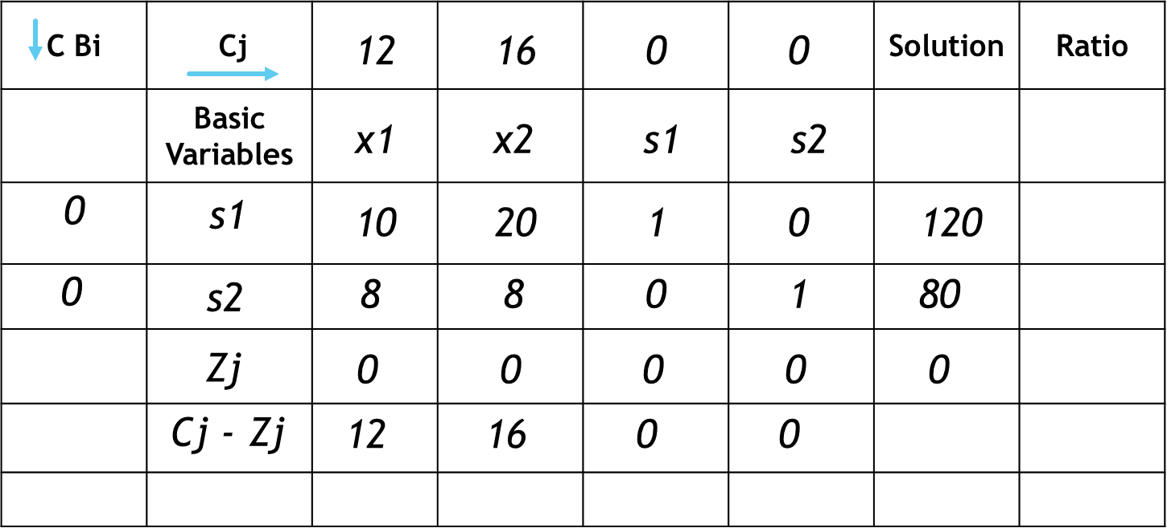
Is it a Optimal Solution ?
For Maximization
All Cj – Zj <= 0
For Minimization
All Cj – Zj >= 0

Slide 7
Step – Reach Optimality
Select the Maximum Value of Cj – Zj
The column of Maximum Cj – Zj value becomes the Key Column
Find the Ratio = Solution / Key Column
The Row with Minimum Value of Ratio is called Key Row
The intersection Point is called Key Element

Slide 8
Step – Example
Key Column
Key Row
120 / 20
C Bi | Cj |  |  |  |  | Solution | Ratio
 | Basic Variables
12 16 0 0
Entering Variable
x1 x2 s1 s2
0
s1
10 20 1 0 120
6
0
s2
8 8 0 1 80
10
Least Positive
Zj
0 0 0 0 0
Cj - Zj
12 16 0 0
Key Element
Leaving Variable
Most Positive

Slide 9
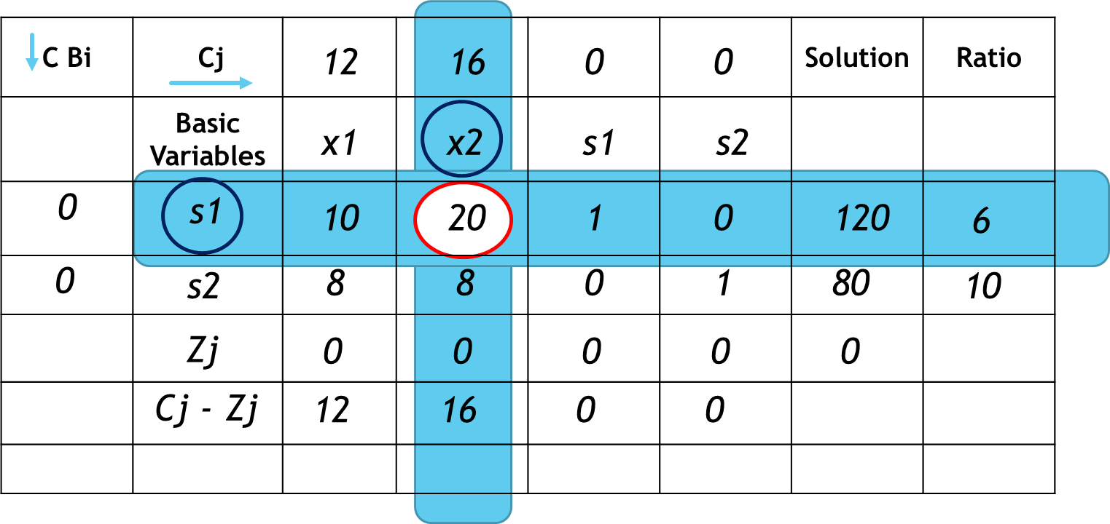
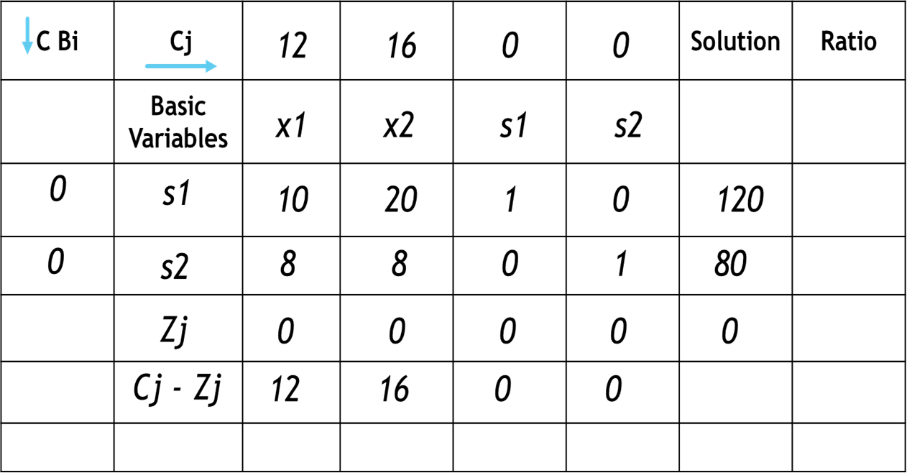
First Iteration Table
New s2 = 8 -
New s2 = 0 -
New s2 = 80-
New s2 = 1 -
New s2 = 8 -
8 x 10
80
8
960
8 x 120
8 x 1
0
8 x 20
8 x 0
160
: 8 -
: 8 – 4 = 4
: 0 -
: 80 -
: 8 -
: 1 -
: 0 – 2/5 = -2/5
: 80 – 48 = 32
: 8 – 8 = 0
: 1 – 0 = 1
20
20
20
20
20
20
20
20
20
20
C Bi | Cj |  |  |  |  | Solution | Ratio
 | Basic Variables
12 16 0 0
x1 x2 s1 s2
16
x2
1/2 1 1/20 0 6
0
s2
4 0 -2/5 1 32
Zj
8 16 4/5 0
Cj - Zj
4 0 -4/5 0
New x2 = old values / Key Element
Corresponding Key Column Value x Corresponding Key Row Value
New s2 =Old Value -
Key Element Value

Slide 10
Iteration 1 – Find Ratio
Key Column
Key Row
C Bi | Cj |  |  |  |  | Solution | Ratio
 | Basic Variables
12 16 0 0
Entering Variable
x1 x2 s1 s2
16
x2
1/2 1 1/20 0 6
12
0
s2
4 0 -2/5 1 32
8
Zj
8 16 4/5 0
Cj - Zj
4 0 -4/5 0
Key Element
Leaving Variable

Slide 11
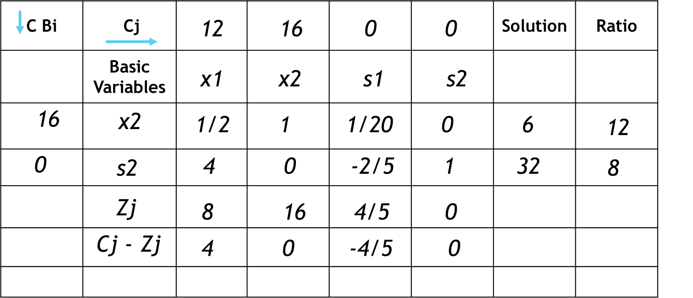
Iteration 2
New x2 = ½ -
New x2 = 1 -
New x2 = 1/20 -
½ x 4
2
0
½ x 0
½ x -2/5
-1/5
-1
1
: ½ -
: 1 -
: ½ – ½ = 0
: 1 – 0 = 1
: 1/20 -
: 1/20 -
x
: 1/20 + 1/20
4
4
4
4
4
4
5
4
C Bi | Cj |  |  |  |  | Solution | Ratio
 | Basic Variables
12 16 0 0
x1 x2 s1 s2
16
x2
0 1 1/10 -1/8 2
12
x1
1 0 -1/10 1/4 8
Zj
12 16 2/5 1 128
Cj - Zj
0 0 -2/5 -1
New x1 = old values / Key Element
Corresponding Key Column Value X Corresponding Key Row Value
New x2 =Old Value -
Key Element Value

Slide 12
Final Optimality
C Bi | Cj |  |  |  |  | Solution | Ratio
 | Basic Variables
12 16 0 0
x1 x2 s1 s2
16
x2
0 1 1/10 -1/8 2
12
x1
1 0 -1/10 1/4 8
Zj
12 16 2/5 1 128
Cj - Zj
0 0 -2/5 -1
x1 = 8
x2 = 2
Z = 128
Maximize Z = 12 x1 + 16 x2

